Slide 1
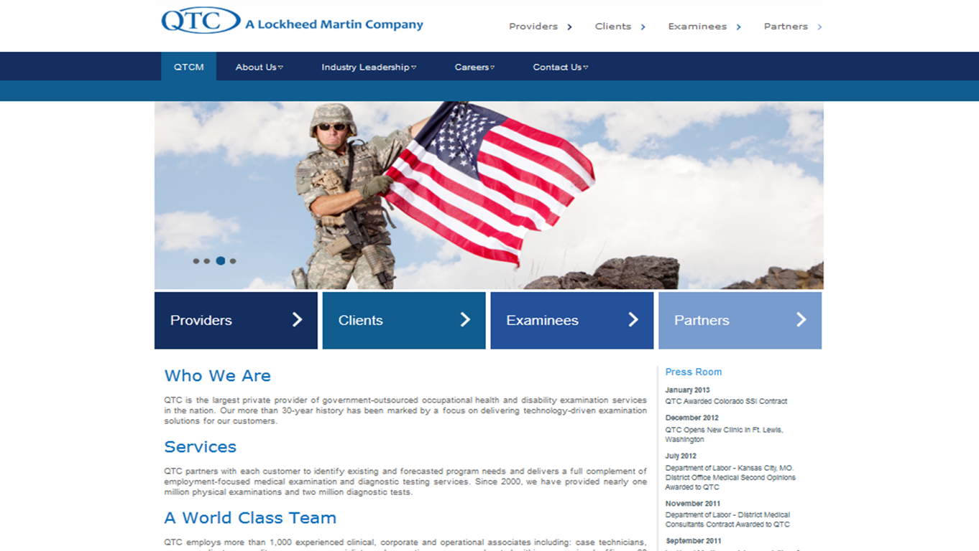
QTC SharePoint Development
The Challenge
QTC, the largest private provider of government-outsourced occupational health and disability examination services in the nation, engaged with Affirma to develop a SharePoint website solution that would allow employees to provide customized information to several categories of users. The solution needed to include a user-friendly method of directing visitors to the pages on the site that addressed their particular questions and concerns.
What We Did
• Created custom wireframes of a new, customer focused website which allows Providers, Clients, Examinees, and Partners to quickly and easily view information that is specifically tailored to their individual needs
• Applied and implemented these wireframes with QTC generated content<br></br>
• Conducted training to teach QTC staff how to update and add content to the new SharePoint site
Results
QTC loves the new design and quickly launched the public-facing website. Visitors to the site, whether they are Providers, Clients, Examinees, or Partners can easily navigate the site and access the pages that are specifically relevant to them. To view this website in action, click here: http://www.qtcm.com

